Slide 1
JavaScript Build Tools: Grunt, Gulp, Webpack
By Mykhailo Torskyi

Slide 2
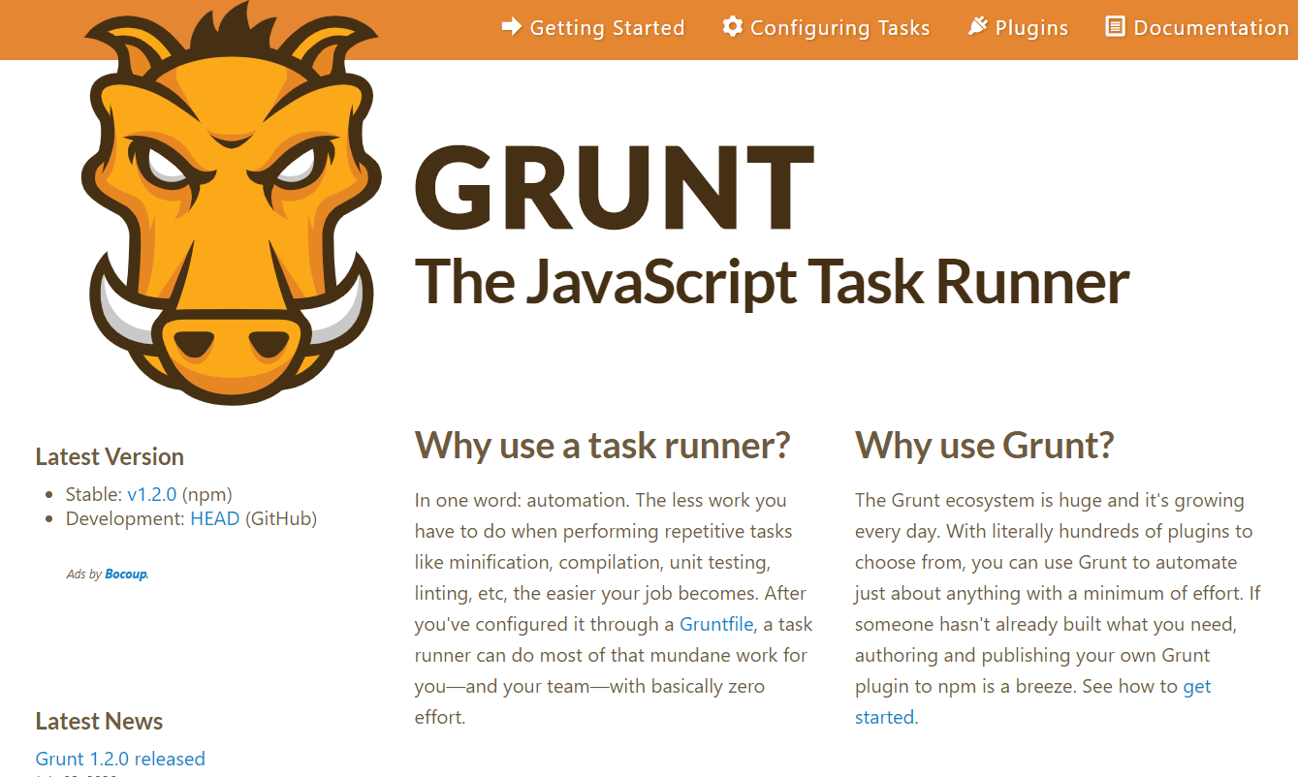

Slide 3
GRUNT
GruntJS is a command-line tool for front-end developers to run predefined repetitive tasks. Whereas, tasks are defined declaratively with configuration objects, which are handled by plugins to keep the core package at a sufficient size. It is used to automate JavaScript workflows like concatenating and minifying JS files, carrying out tests, refreshing browser to upload script changes and so on
Advantages
Huge ecosystem of plugins to perform various tasks at the same time (over 6010 items in Grunt plugin registry)
Disadvantages
Can become complicated as the configuration grows
Lack of flexibility with uncommon tasks
Tend to outdating

Slide 4
Gulp
Eighteen months later after Grunt, GulpJS was released. It is another toolkit for defining and running time-consuming tasks, but it takes a different approach. Comparing Grunt vs Gulp, the core difference is that where GruntJS uses configuration objects to define tasks declaratively, Gulp defines them as JavaScript functions. It builds on top of the piping concepts (sources, filters, sinks)

Slide 5
Pros:
Greater clarity of current processes and more control over the flow
Large ecosystem of Gulp plugins, while each of them can accomplish a particular task (over 2770 various plugins for different purposes)
Faster performance due to the stream usage and in-memory operations
Requires less amount of code, comparing to Grunt
Cons:
Initially streams and promises are hard to understand

Slide 6
This is one of the major differences in Gulp vs Grunt comparison; however, the dilemma may be less about configuration and coding, but about how comfortable your team is with node streams. Gulp is more about coding and usage of single-purpose plugins, while Grunt relies on configuration and multi-purpose plugins.

Slide 7
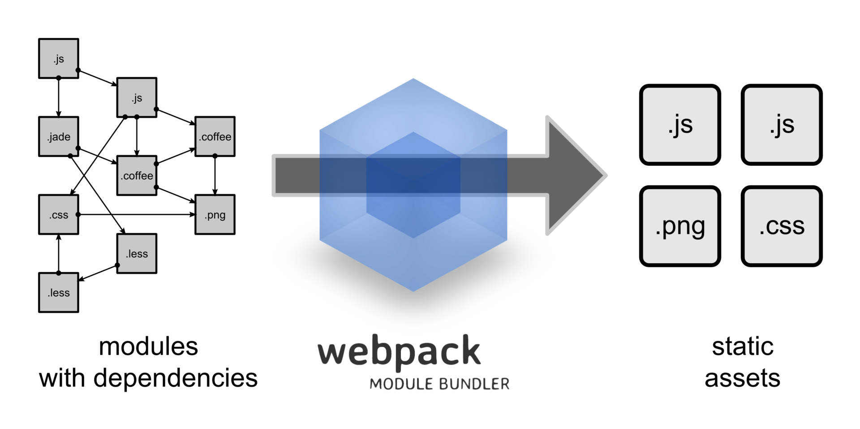

Slide 8
WEBPACK
Webpack is a module bundler, though it is quite often used instead of Gulp or Grunt task runners. This advanced tool provides developers with control over how it splits the modules, allowing them to adjust builds to particular situations and workaround solutions that don't function properly out of the box
Pros:
The idea of dependency graph in Webpack ensures easier splitting of code, control over assets processing, and elimination of dead assets
Multiple options and features right out of the box
Webpack-dev-server supports hot and live reloading
Cons:
Initially it is difficult to configure

Slide 9
WEBPACK CONFIGURATION
Entry
Output
Loaders
Plugins

Slide 10
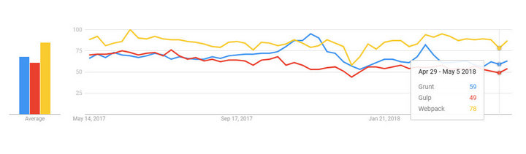

Slide 11


